Slide 1
Centripetal Force

Slide 2
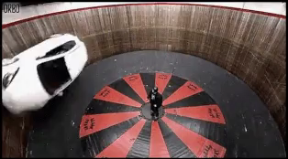
After completing this Smart Lesson you will be able to:
Identify centripetal forces.
Explain the effect of centripetal force on the motion of an object.
Perform calculations of force in circular motion.

Slide 3
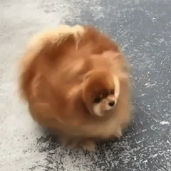
In this lesson you'll learn about centripetal force in a variety of everyday situations. Ferris wheels, washing machines, and poi all rely on centripetal force to function correctly.
If it weren't for centripetal force, the planet Earth would fly off into space! Centripetal force stops the hair from coming off this dog:

Slide 4
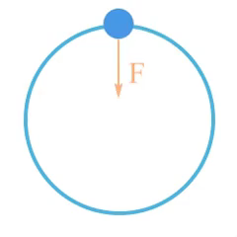
Centripetal Force
An object travelling in circular motion accelerates toward the centre of the circle. There must be a force acting on the object to cause this acceleration.
This force is the centripetal (centre seeking) force, and points toward the centre of the circle of motion.
Acceleration and net force always point in the same direction, so the force must point toward the centre of the circle.

Slide 5
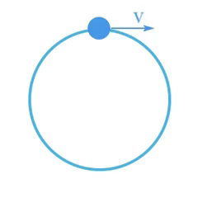
Centripetal force doesn't change the speed of an object, but does affect the direction of motion of an object.
Therefore, the centripetal force changes the velocity of an object.

Slide 6
If the centripetal force disappears, the direction of motion of the object would stop changing, and the object would continue along its instantaneous velocity vector.

Slide 7

When travelling around a corner in a car you are travelling in circular motion, and can probably feel a force pushing you outward, away from the centre of circular motion.
This is known as centrifugal force, and is a "fictitious" or "pseudo" force that you feel while travelling in a circle. Your body wants to keep travelling in the same direction, but the car is pulling you with it as it goes around the corner. The true force is to the centre of the corner.
It's important not to use centrifugal force when you mean centripetal force.

Slide 8
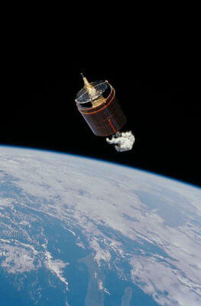
Example
Use your knowledge of forces to identify the centripetal force that keeps satellites in circular motion. The force must be pushing or pulling the satellites toward the centre of the Earth. The force might be gravity, tension, spring, support, or applied.

Slide 9
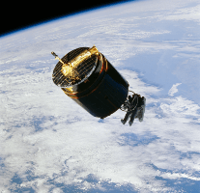
 |  | Solution
 |  | Satellites orbiting the Earth are affected by the force of gravity. The force of gravity points from the satellite toward the centre of the Earth, accelerating the satellite toward the ground. The centripetal force is gravity.

Slide 10
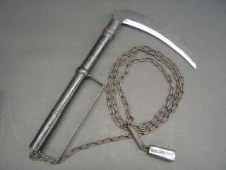
Example
The weighted chain of a kusarigama is swung in a circle, then released to tangle an opponent or their weapon. Use your knowledge of forces to identify the centripetal force that keeps the chain in circular motion. The force might be gravity, tension, spring, support, or applied.

Slide 11
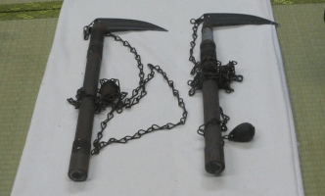
Solution
The weighted chain of a kusarigama is swung in a circle, then released to tangle an opponent or their weapon. Tension in the chain keeps the weight swinging in a circle before it's released. The centripetal force is tension.

Slide 12
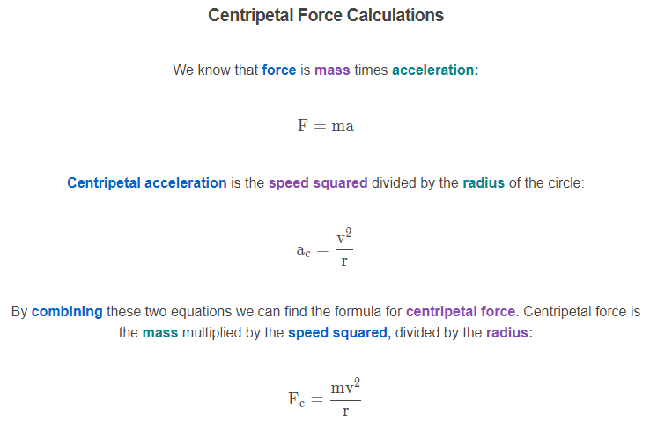

Slide 13
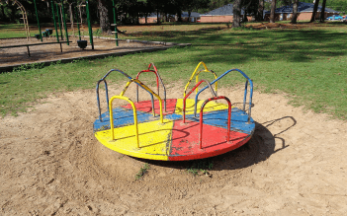
This roundabout has a radius of 1.4 m and is spun at 5.4 ms−1.
A child of mass 42 kg hangs on while the roundabout spins. What force must the child apply to hold onto the roundabout?

Slide 14
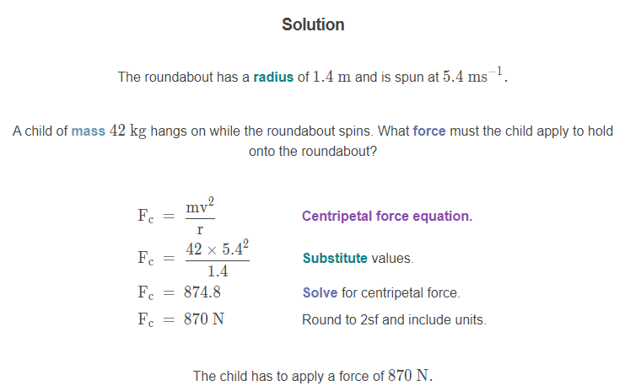

Slide 15
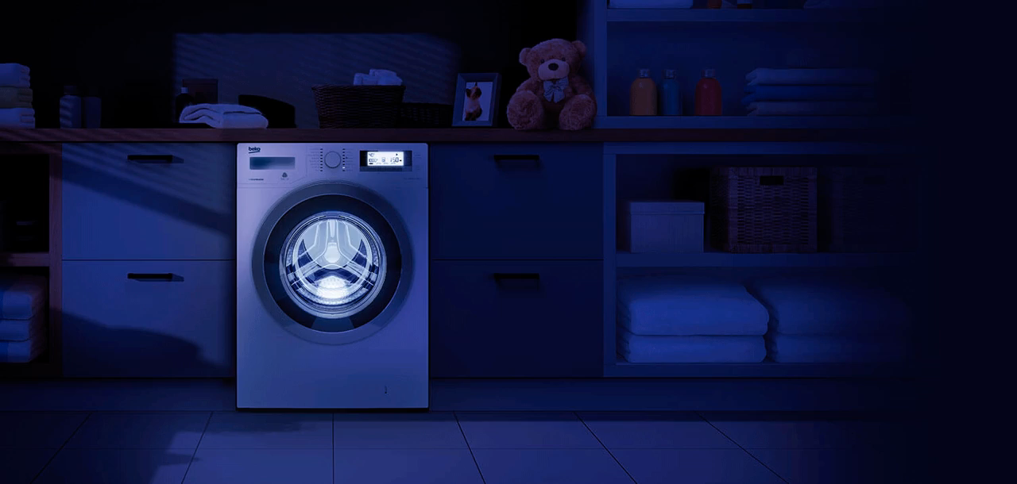
Example
An ordinary washing machine has a radius of 0.24 m and can withstand a maximum force of 43000 N at a speed of 37 ms−1.
What is the maximum mass of clothing that the washing machine can wash?

Slide 16
